Slide 1
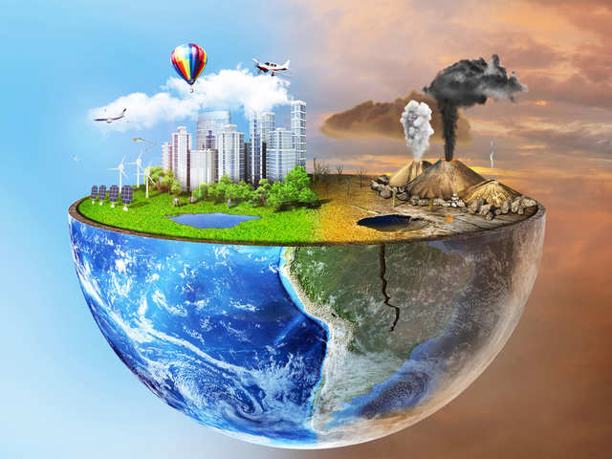
Presentation on pollution

Slide 2
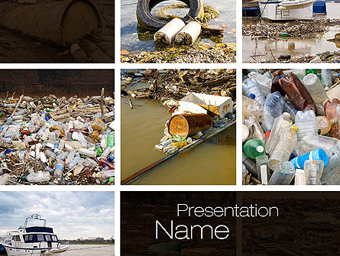
Make your next PowerPoint, Google Slides, or Keynote presentation more effective with our professionally designed Pollution of Water template. Improve the way you present seminars, webinars and lectures. Make more exciting sales presentations, trade show displays and product promotions, or use them in any educational setting for more impact and greater retention.

Slide 3
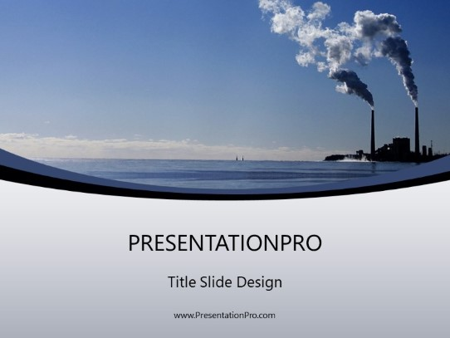
Add dynamic action to your work with this fully editable and professional Pollution PowerPoint Template to complete all your reports and personal or professional presentations

Slide 4
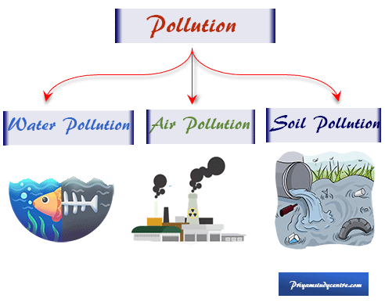
For scientific solutions to pollution, the harmful substance or molecule can be dispersed, diluted, decomposed, recycled, or stored in some harmless form.

Slide 5


